Slide 1
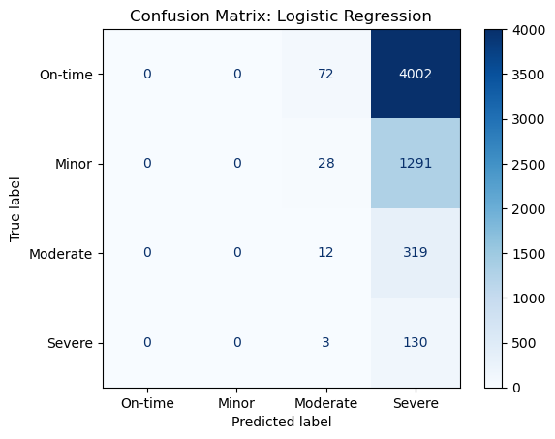
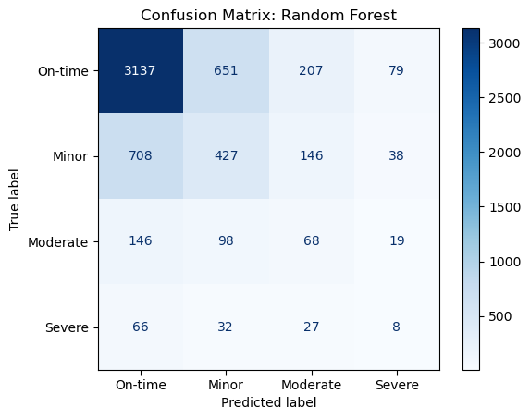
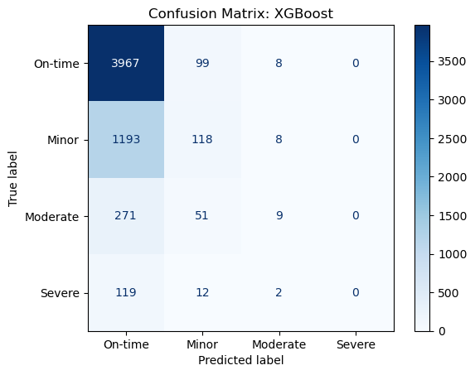
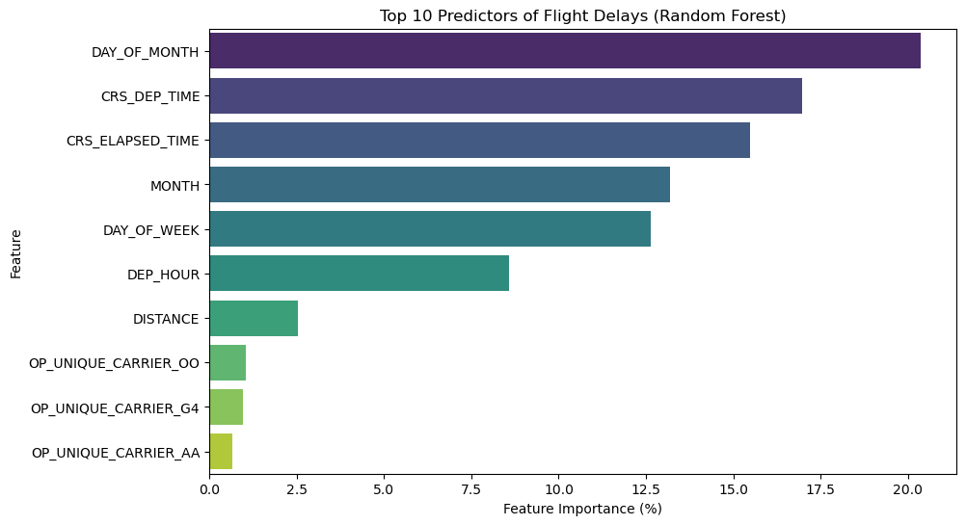
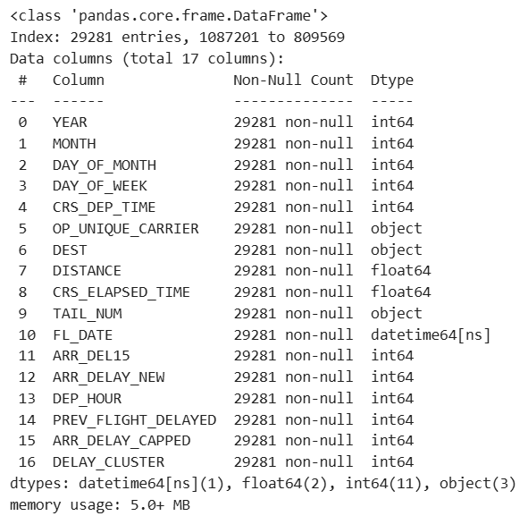
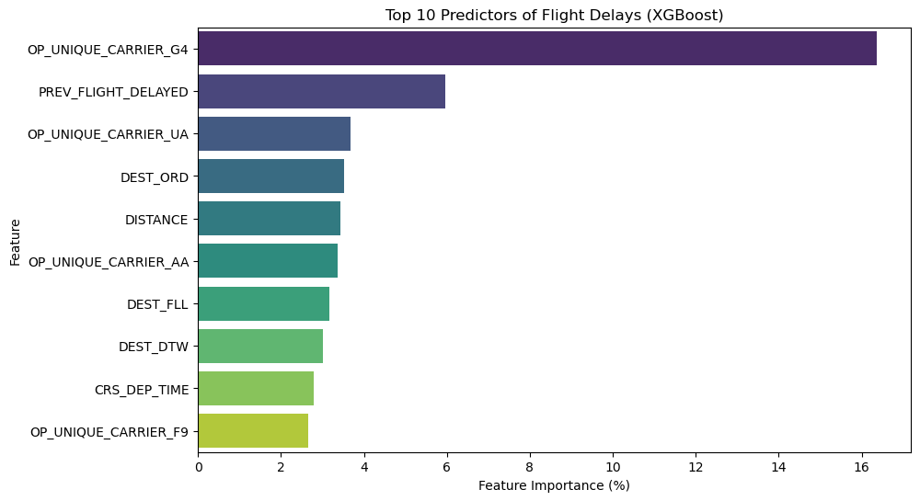
Flight Arrival Delay Prediction: A Multi-Class Severity Approach
Gracie Nguyen, Leah Ho, Nam Nguyen
DATA 300 · Statistical and Machine Learning · Spring 2026
ABSTRACT
LOGISTIC REGRESSION (LR)
RANDOM FOREST (RF)
XGBOOST (XGB)
LIMITATIONS
Using BTS on-time data, this project predicts how severely flights from Harrisburg International (MDT) will be delayed. KMeans clustering sorted delays into four classes — on-time, minor, moderate, and severe — based on actual delay distributions. Three models (Logistic Regression, Random Forest, XGBoost) were trained on features like carrier, destination, departure hour, day of week, distance, and prior-leg delay status.
• Accurate Severe delay prediction remained difficult
• Minority class recall remained relatively low
• Weather variables were not integrated
• Airport congestion variables were unavailable
• Advanced resampling techniques such as SMOTE were not fully explored
• Historical delay data by airline was not exploited
MOTIVATION
Which model yields the best result when it comes to predicting arrival delays for flights departing from MDT?
DATA & METHODS
CONCLUSION
Dataset: Bureau of Transportation Statistics (BTS)
Scope: Approx. 29,281 departures from MDT Target: Four levels of delay severity (On-Time, Minor, Moderate, Severe) Method: Stratified train/test split
FEATURES IMPORTANCE
Results | LR | RF | XGB
Accuracy | 0.0242 | 0.6215 | 0.6990
Weighted F1 | 0.0040 | 0.6240 | 0.6095
Weighted ROC-AUC | 0.5872 | 0.6626 | 0.6869
Weighted Average Precision | 0.5918 | 0.6447 | 0.6648
Ensemble methods substantially outperformed Logistic Regression, which nearly collapsed across all metrics. XGBoost led in accuracy (0.699), weighted ROC-AUC (0.6869), and weighted average precision (0.6648), making it the stronger model for overall discrimination. Random Forest, however, achieved the highest weighted F1-score (0.6240), suggesting better balance across classes, making it the preferred choice when correctly identifying serious delay categories is the operational priority.
FEATURE ENGINEERING
REFERENCE
Snell, Kenney, et al. "Predicting Flight Delays Using Machine Learning." (2026).
Gui, Guan, et al. "Flight delay prediction based on aviation big data and machine learning." IEEE Transactions on Vehicular Technology 69.1 (2019): 140-150.
Dataset: U.S. Bureau of Transportation Statistics · Focus Airport: MDT

